Slide 1

CZ1115 Mini Project
FSP7
Team 5
Dataset:
The Movies Database APIs
Group Members:
Xu Shaoyi U2022526B
Chua Yi Xiang U2022391F
Lau Xin Wei U2020986E
Notes:
Slide 1-4
Welcome to our project video! I am Yixiang and these are my teammates. Today, we will be sharing with you our project on the TMDB movie dataset. Based on the existing dataset we have gathered, our problem statement is predicting whether a movie will be nominated for the Oscars Best Picture Award. First, we will talk about how we extracted and cleaned the data.
[Slide 6]
We first collected the data through the movie database website by using the API provided by TMDB, giving us 10000 movies with information such as genre, revenue and more.
[Slide 9 + 11]
We then retrieved the list of oscar best pictures nominations by scraping content from Wikipedia and merged the 2 datasets together by matching the names of the films, with 1 for nominated and 0 for not nominated.
[Slide 13]
We then removed rows with NaN or empty fields for better accuracy in our model.
[Slide 14]
We also remove irrelevant predictor variables such as poster path urls.
[Slide 15]
This is the result of before and after replacing the NaN values with 0s.
[Slide 16]
This is the result before and after removing the rows with 0s.
[Slide 17]
After removing the rows, we then reclassify the data types of each column to their correct type as shown in this slide.
[Slide 18 to 21]
Most data in JSON format could be converted to a DataFrame. Columns with multiple values in a list, such as genres, are instead stored as a string and had to be converted to a hash-able data structure in order for pandas to process them. Furthermore, we will also apply one-hot encoding as it ensures that all categorical data have equal weightage, thereby reducing bias introduced by encoding of different values for each category. This is applied for genres, production companies, and production countries.
[Slide 22]
Finally, we add a new column called profit which is the difference between revenue and budget as we are interested to see how profits affect the probability of nomination for an oscars award.
[Slide 23]
We then filter out unreleased movies from our dataset, ending up with 4225 rows and 144 columns in our dataframe.
YX
Now, lets go through data exploration and visualization. Here is a brief overview of our univariate analysis using a boxplot, histogram and violin plot for all of our numerical variables and count plots for our categorical variables. Now we perform bivariate analysis of variables against oscars. Surprisingly, budget, revenue and profit had very little correlation between whether a movie would win an oscars or not. Movies with loner run times and higher vote averages were more likely to be nominated for Best Pictures, while vote count was a negligible factor in affecting the chances of a promotion. As for language, Movies in english were the most likely to be nominated. There was also a noticeable increase in oscar nominations as the release month of the movie increases, peaking at december. For genres, Drama movies has the highest correlation with being nominated while Action movies has the lowest, correlation, being negative.
[Slide 42]
As our problem is centered around the likelihood of a movie to be nominated for oscars best pictures awards, our problem is, by nature, a classification-type problem (with 1 representing nominated, and 0 representing not nominated).
Slide 41
For the purpose of our problem, we will be employing supervised learning by splitting our released DataFrame by a 70-to-30% ratio for training the prediction model and subsequently testing the model’s accuracy.
In order to understand the best, for the purpose of comparison, our team will be making comparisons across the typical classification models such as Sklearn’s ClassificationTree and Random Forest. These classification algorithms provide us with the ability to build multivariable models and perform effective predictions building out of the box.
Slide 42
Plotting a confusion matrix with the True Positive, True negative, False positive, False Negative rates will give us a gauge of the accuracy of our data. More importantly, we should focus on the false positive rates as these are movies that are wrongly predicted to have got an oscar nomination.
Slide 43
We then Individually tested the decision tree classifier on three randomly picked samples from the dataset and the probability of each prediction.
Random Forest
However, our results are rather unsatisfactory. Hence, to improve accuracy of our classification tree, especially with regards to our False Negative Rate, we will utilise random forest algorithms. Random Forest is simply a bunch of decision trees bundled together. Random foresting incorporates bagging, which samples a certain amount of data from the entire data set, trains a decision tree based on the samples taken, then replaces the sampled data taken from the dataset. The process is then repeated again many times to produce many different classification trees. Afterwards, it takes the majority vote which is the most common category used to split the tree at each depth level. It also has another parameter that controls how many predictors to try when finding the best split along with bagging, by taking a subset of predictors along with a subset of data. This reduces correlation between trees in the data and reduces the impact of high correlations between predictor variables. In this case, we decide on 100 as the number of classification trees created randomly with a depth of 4. We increased the number to 1000 and got a much better result. However, afterwards we realised that the best way of finding the correct parameters would be to use hyperparameter tuning to return the best estimator and depth. Comparing with with our other decision trees, this gave us a model with the highest false positive rate.
This is a small portion of the massive random forest that we have printed out after hypertune parameter.
Insights:
Now, we will talk about the insights we have gathered from this project. The most important factors that affect whether a movie will be nominated are genre, production countries, vote average, year and runtime.
From our data exploratory, it can be concluded that dramas are the most popular genre for the best pictures award. This may be because dramas have more potential for a better storyline as compared to other genres such as horror and action since these films would focus more on the “scary” and “action” effects and not as much on the development of plot.
The best pictures award is awarded to films as the most prestigious award which means that it has to have a rich plot and drama would be the genre that best fits into this criteria.
Next, most of the movies in the dataset are produced by the US which may cause a bias in the prediction of how production countries affect the chances of a movie being nominated for this award.
The prediction of vote average may not be accurate as the difference in demographics of oscar nominators and users who vote on TMDB may cause an inaccuracy in the prediction. Also, vote average depends on the total number of people that have voted for the movie. For example, if a movie only has 1 5 star rating, its vote average would be 5 which is not accurate as the sample size is too small. We attempted to retrieve the demographic data from imdb, however such information was not available to public users.
Next, the year a movie is released affects its chances of being nominated as well because the number of movies produced in the past is much less as compared to recent years but the number of oscar nominations over the years remain the same. This means that in the past, a larger percentage of movies are nominated which explains the strong correlation between nominations and year release.
The runtime of a movie also affects the amount of content they are able to include in the movie which affects the overall plot and cohesiveness presented to the judges which is why it is an important factor in our prediction.
Ultimately, we believe our model is unable to accurately solve our problem statement because oscar nominations are very subjective - tastes change over the years and trends come and go. There are also other factors that are not quantifiable such as networking with oscars alumni which also affects a film’s chance of being nominated. However, through this project, we definitely gained a better insight on data analysis and acquired new skills beyond the scope of what is taught to us in this course.
Here is a slide on our team’s work allocation:
xin wei mainly focused on the extraction and cleaning of data, me, Shaoyi focused on the classification and prediction, insights and views portion while yixiang focused on the data exploratory and random forest portions.
most important:
genres
production country
vote average
runtime
least important:
vote count
month
profit
budget
revenue
f you used ML (regression, classification, or something else); mention mainly WHICH one(s).
You may now briefly CLARIFY why and how the ML problem(s) aim(s) to solve your objective.
How did you apply ML technique(s) to SOLVE your problem? Which model(s), how and why?
Did you only use tools and techniques learned in this course? What ELSE did you learn/try?
*highlighted in bold to be answered in comparison slide
[Slide 43]

Slide 2

Table of Contents
Problem Statement
Data Extraction
Dataset Description
Dataset Cleaning
Data Exploration and Visualization
Classification + Prediction
Random Forest
Insights and Recommendations
Conclusion
References

Slide 3

Problem Statement
1.

Slide 4
Problem Statement
Based on the existing dataset we have gathered, predict whether a movie will be nominated for the Oscars Best Picture Award.

Slide 5

Data Extraction
2.
First, we start by extracting the data from the TMDB API

Slide 6
Data Extraction
TMDB API_KEY : 8a21d3cc9906f1fbc368f69df69858a0
Movie List EndPoint : https://api.themoviedb.org/4/discover/movie?api_key={API_KEY}&page={PAGE_NO}
Movie Details EndPoint : https://api.themoviedb.org/3/movie/{MOVIE_ID}?api_key={API_KEY}
Wikipedia Endpoint : https://en.wikipedia.org/wiki/Academy_Award_for_Best_Picture

Slide 7
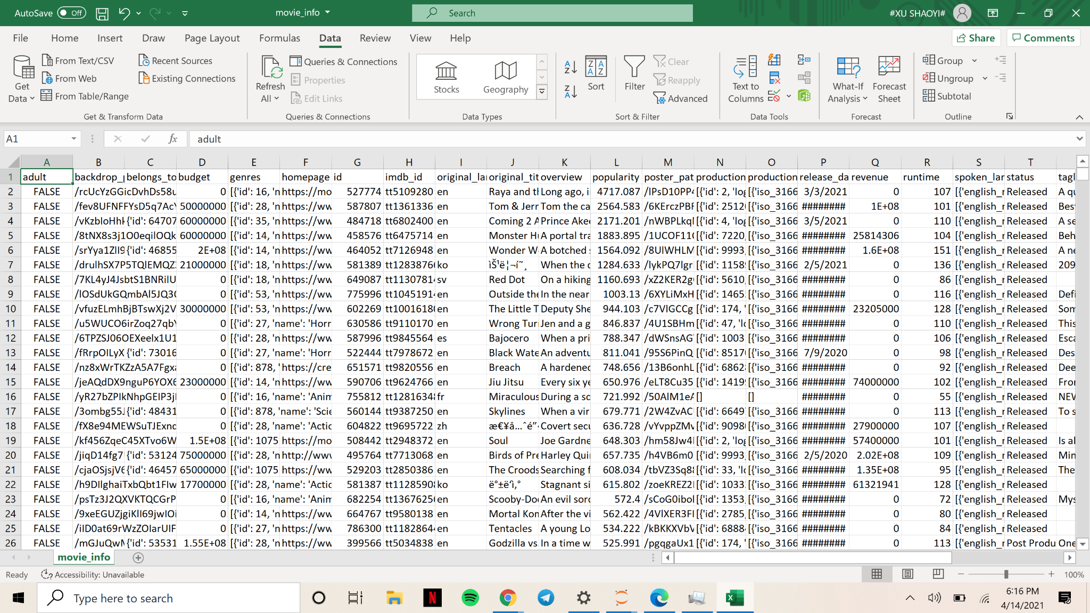
Data Extraction
After API extracting, The TMDB Movies dataset in csv format:

Slide 8
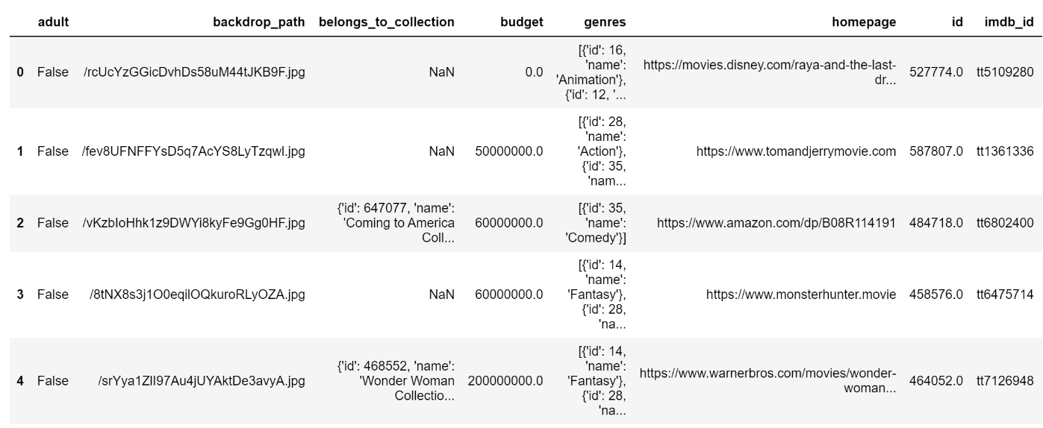
Data Extraction
TMDB movies dataset:

Slide 9
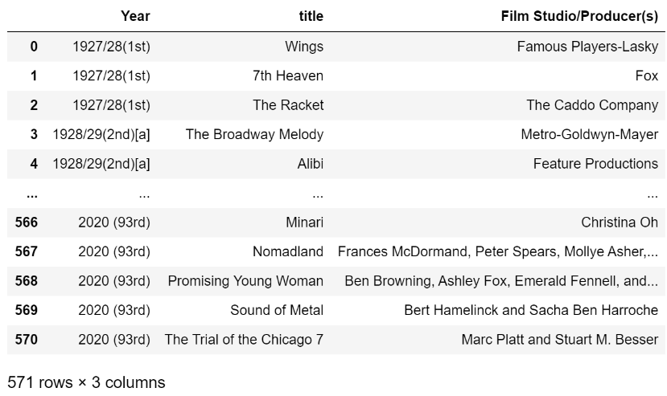
Data Extraction
Best Picture Oscar Awards dataset from Wikipedia:

Slide 10

Data Description
3.
The following is the data that we got from the extraction

Slide 11
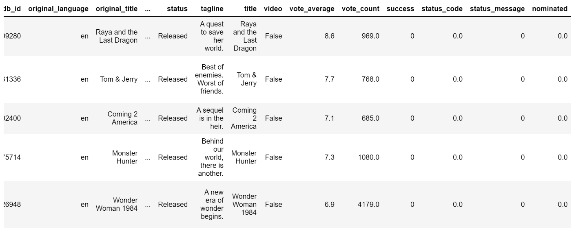
Dataset Description
Combining the movies dataset from TMDB and the Best Picture Awards dataset from Wikipedia:
Number of rows: 10000
Number of columns: 28

Slide 12

Data Cleaning
4.
Let’s start by doing some data cleaning and preparation.

Slide 13
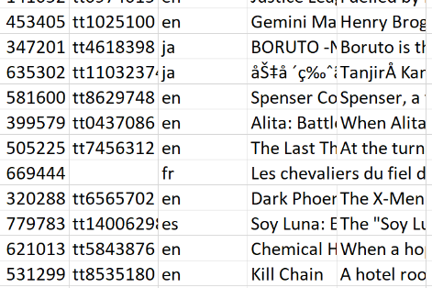
Data Cleaning
First, we will start by dropping all rows with NaN values, 0 and empty list values such as these:

Slide 14
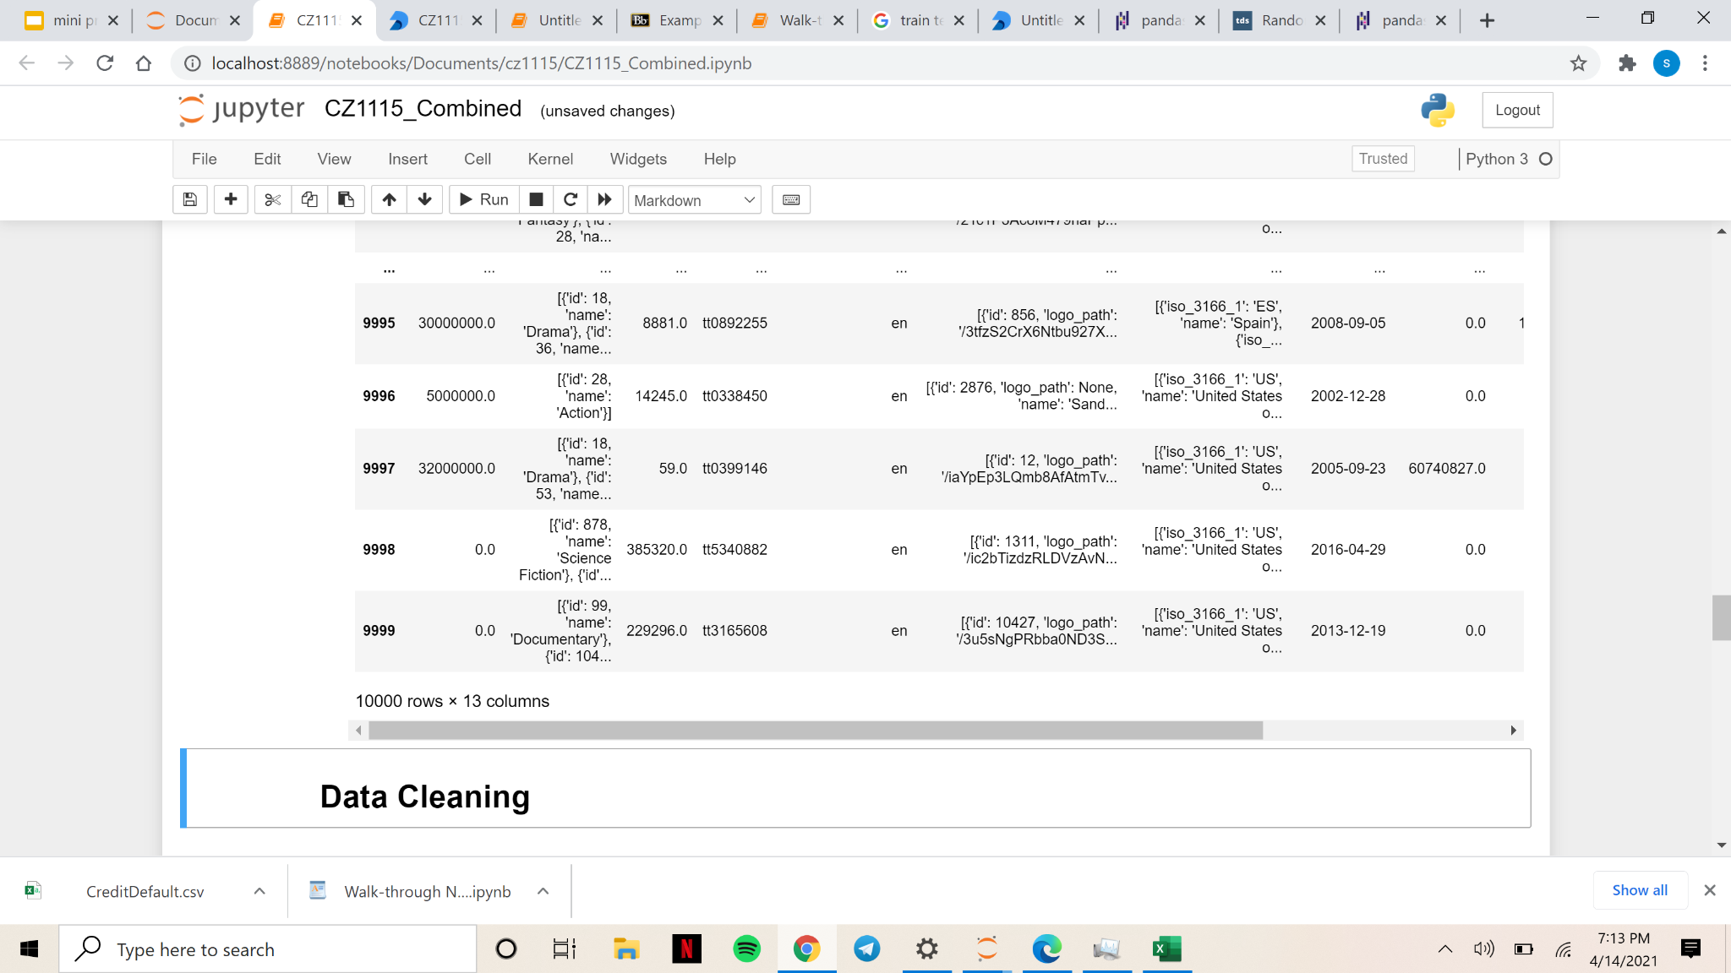
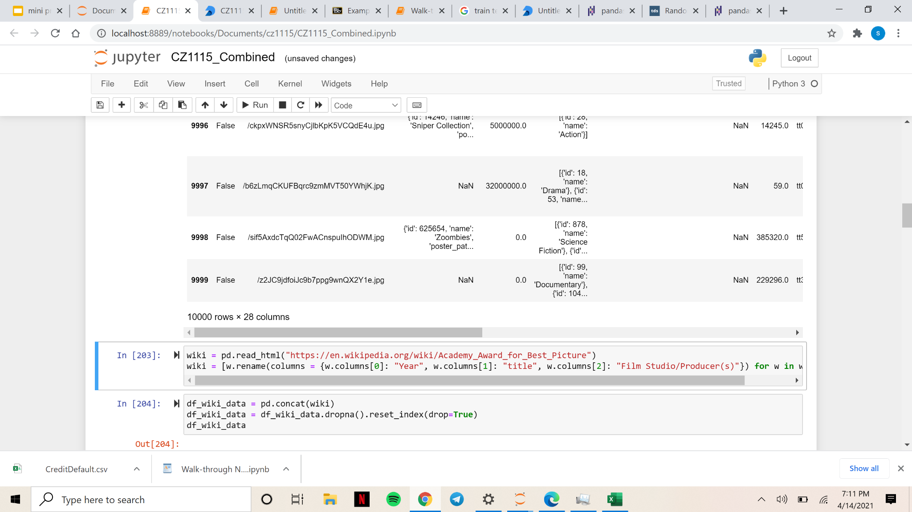
Data Cleaning
Drop columns:
adult, backdrop_path, belongs_to_collection, homepage, original_title, overview, popularity, poster_path, spoken_languages, tagline, title, video, success, status_code status_message
Columns to keep:
budget, genres, id, imdb_id, original_language, production_companies, production_countries, release_date, revenue, runtime, status, vote_average, vote_count
Before:
After dropping columns:

Slide 15
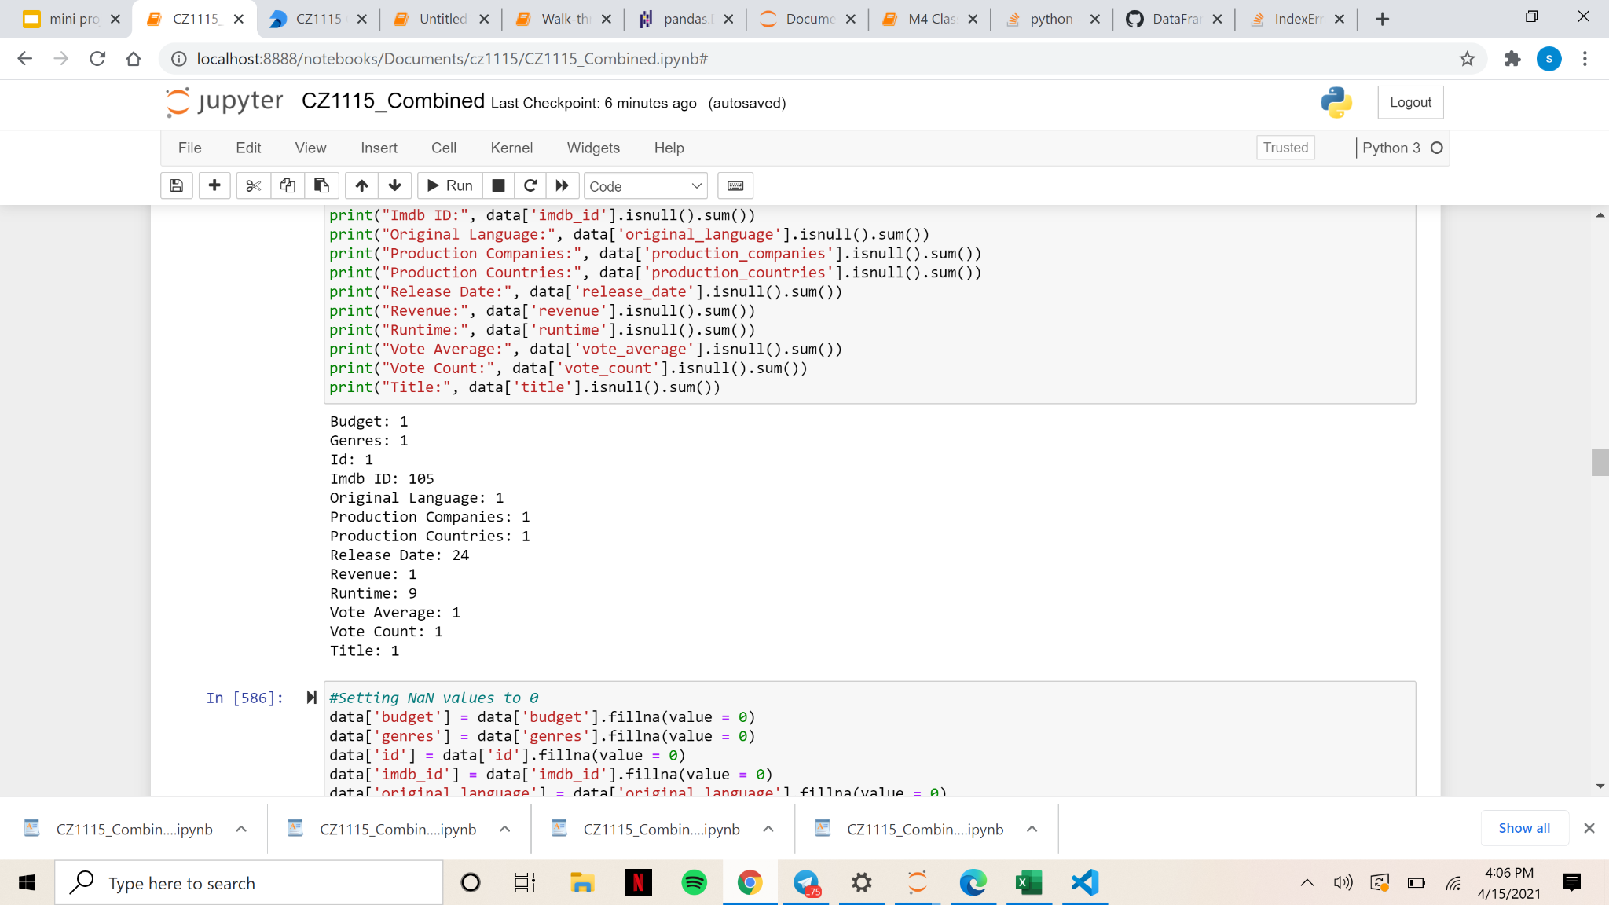
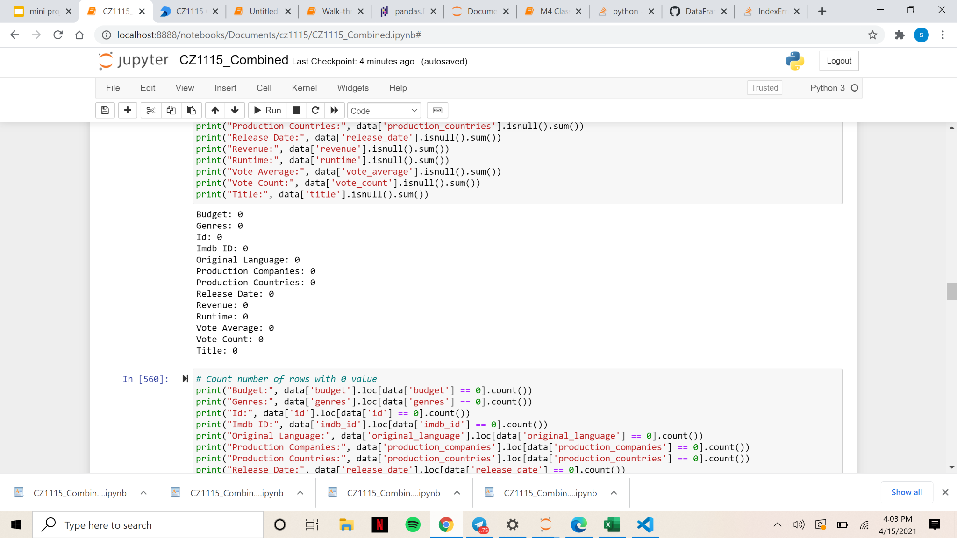
Data Cleaning
Replace NaN values with 0 and print the number of NaN values again to make sure there are none:
Number of NaN values before replacing NaN values with 0
Number of NaN values after replacing NaN values with 0

Slide 16
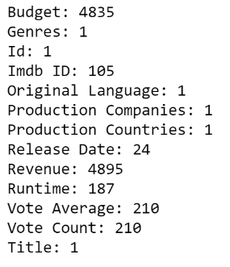
Data Cleaning
Now that all NaN values are replaced with 0, we can remove all rows with 0 values
Number of 0 values in each column before removing 0 values
Number of 0 values in each column after removing 0 values

Slide 17
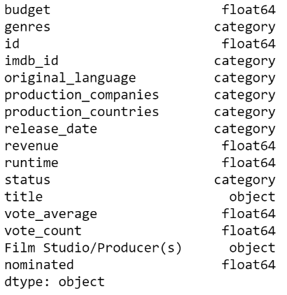
Data Cleaning
Set numerical data types as float64 and categorical data types as categorical

Slide 18
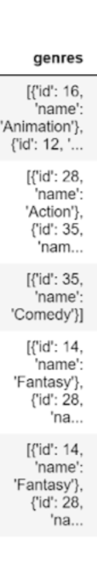
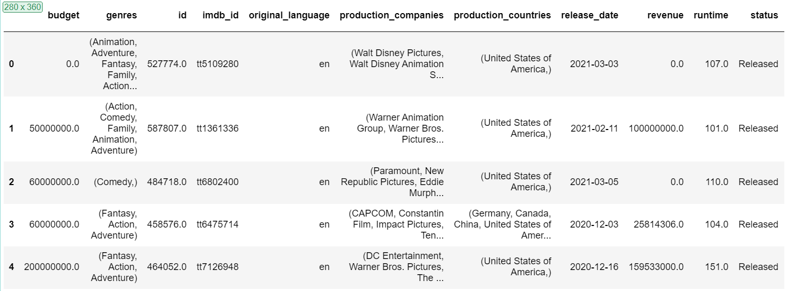
Data Cleaning
Parsing list of JSONs into Tuples

Slide 19
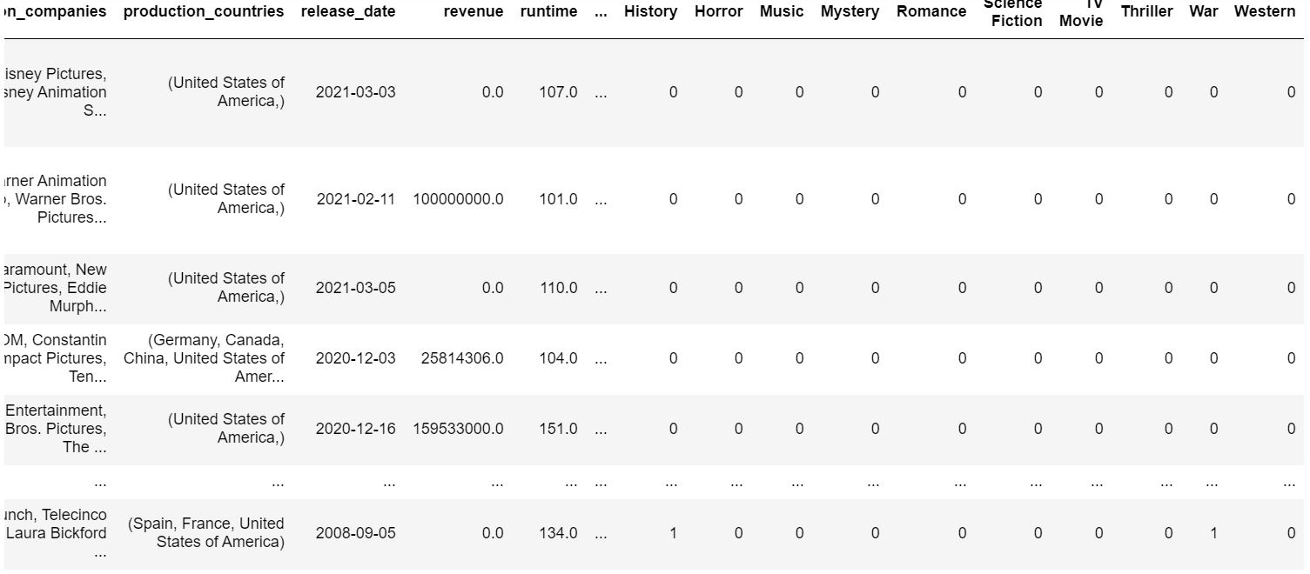
Data Cleaning
One-hot encoding for categorical data types excluding release_date:
An example of one-hot encoding for genres

Slide 20
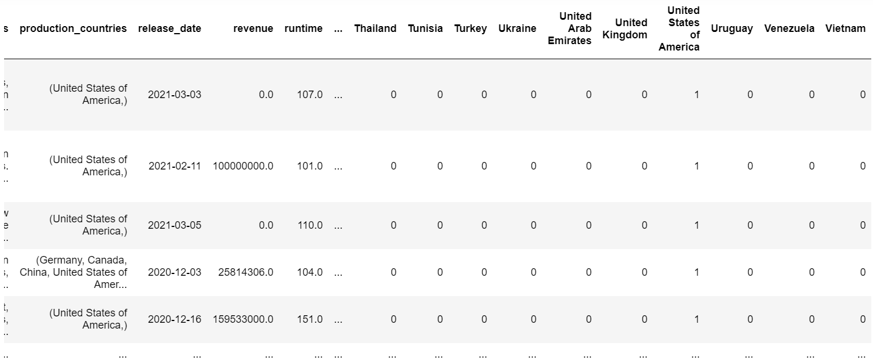
Data Cleaning
An example of one-hot encoding for production_countries

Slide 21
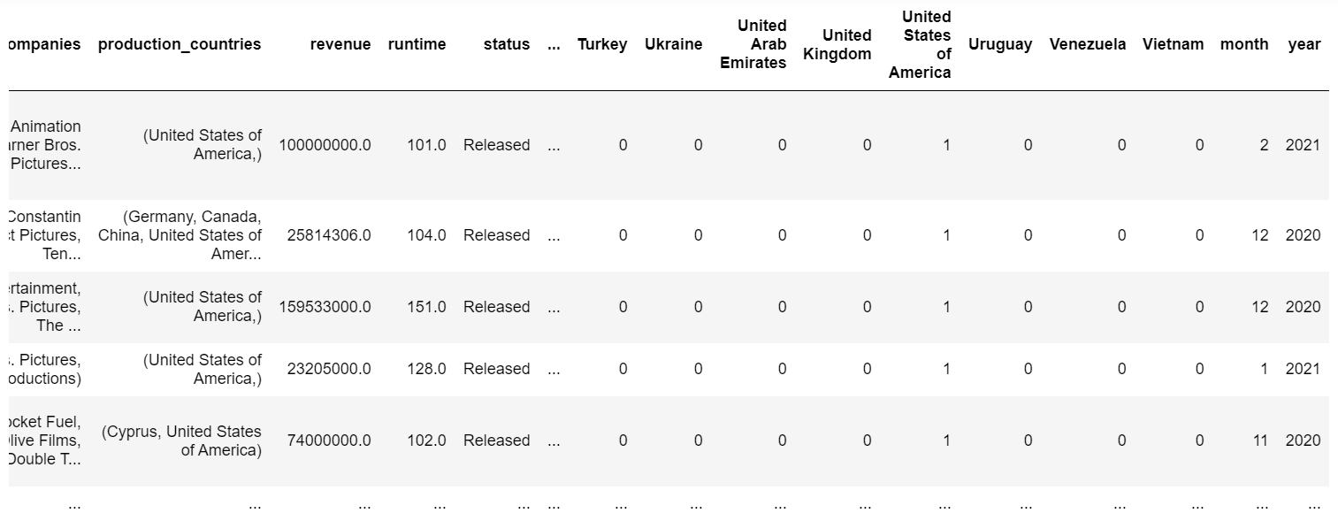
Data Cleaning
Since release_date cannot be encoded using one hot encoding, we will separate it into its month and year format

Slide 22
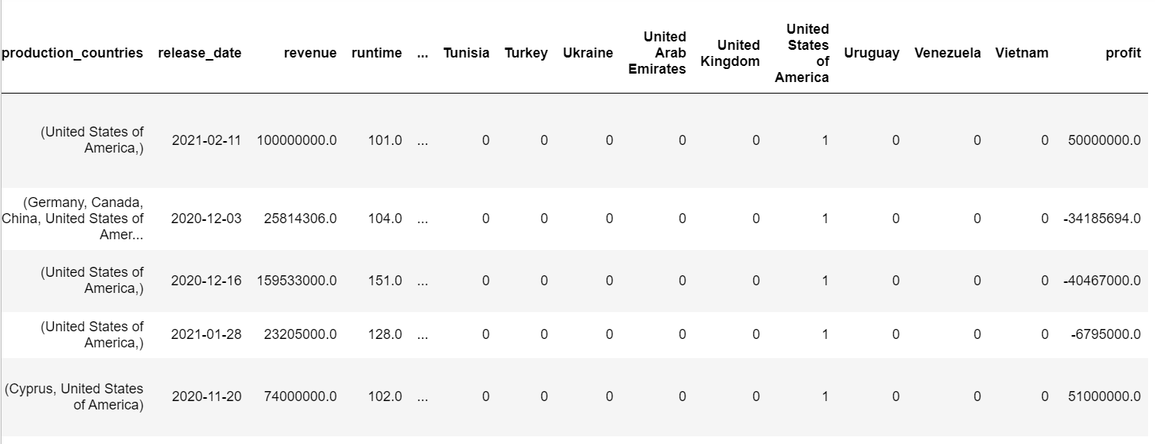
Data Cleaning
With budget and revenue in our dataset, we can derive the profit of each movie since profit = revenue - budget

Slide 23
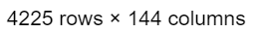
Data Cleaning
Finally, separate the dataset into released and unreleased movies based on the status of the dataset. This is the final shape of our dataset after data cleaning:

Slide 24

Data Exploration and Visualization
5.

Slide 25
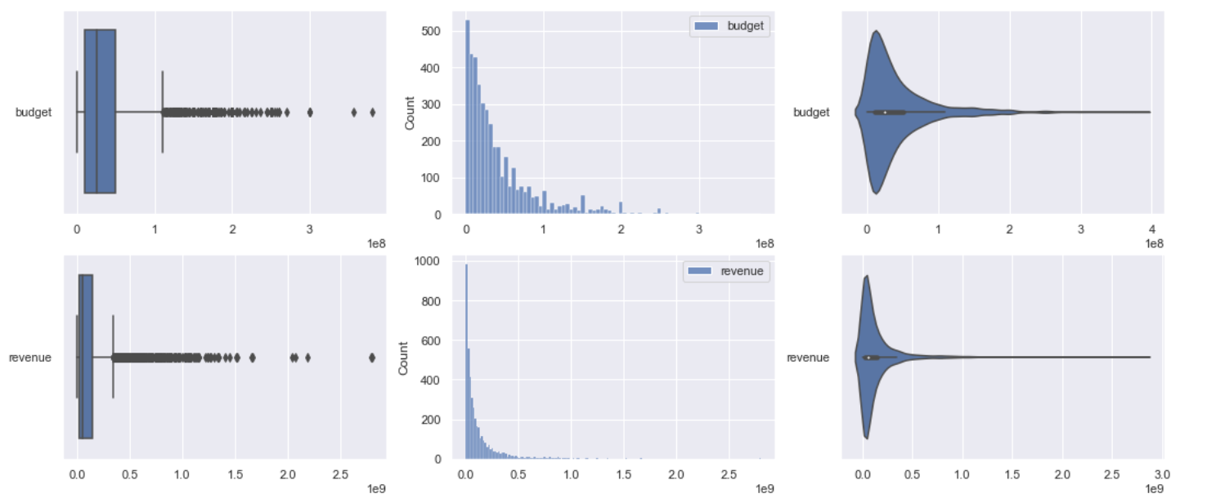
Data Exploration
These are the various boxplots, histograms and violin plots for each of our numeric data

Slide 26
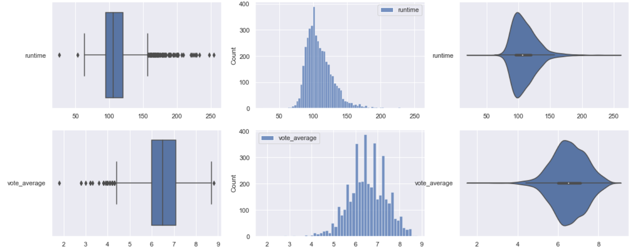
Data Exploration
These are the various boxplots, histograms and violin plots for each of our numeric data

Slide 27
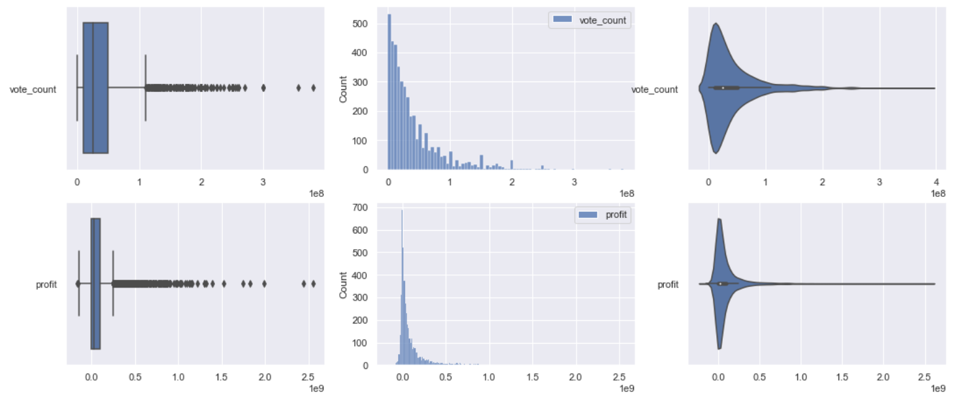
Data Exploration
These are the various boxplots, histograms and violin plots for each of our numeric data

Slide 28
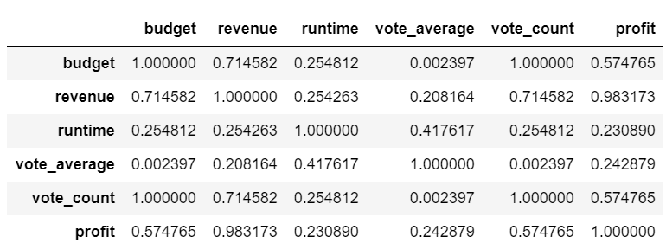
Data Exploration
Correlation Matrix:

Slide 29
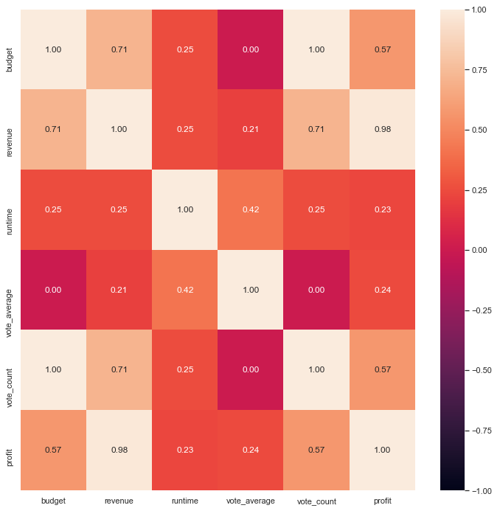
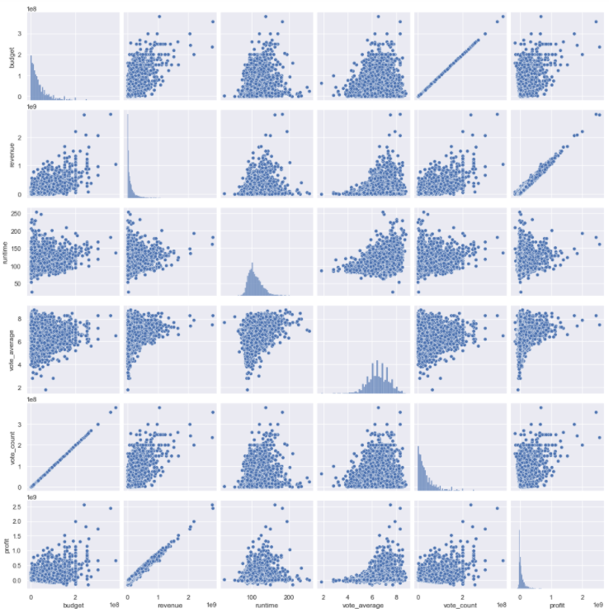
Data Exploration
Heatmap of Correlation Matrix:
Pair plot of variables against each other:

Slide 30
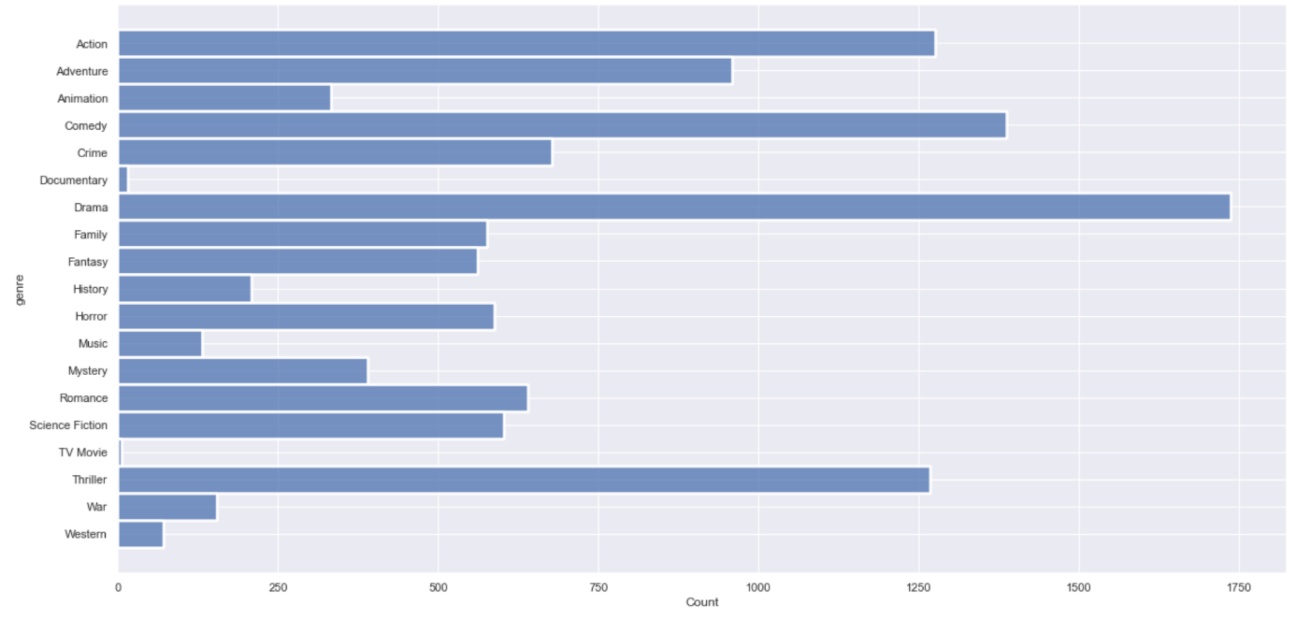
Data Exploration
Histogram of the various genres:

Slide 31
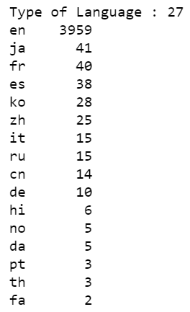
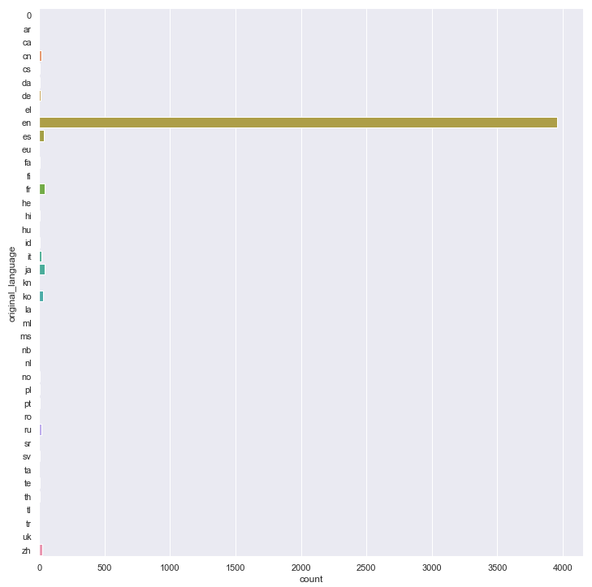
Data Exploration
A count and catplot of original languages spoken:

Slide 32
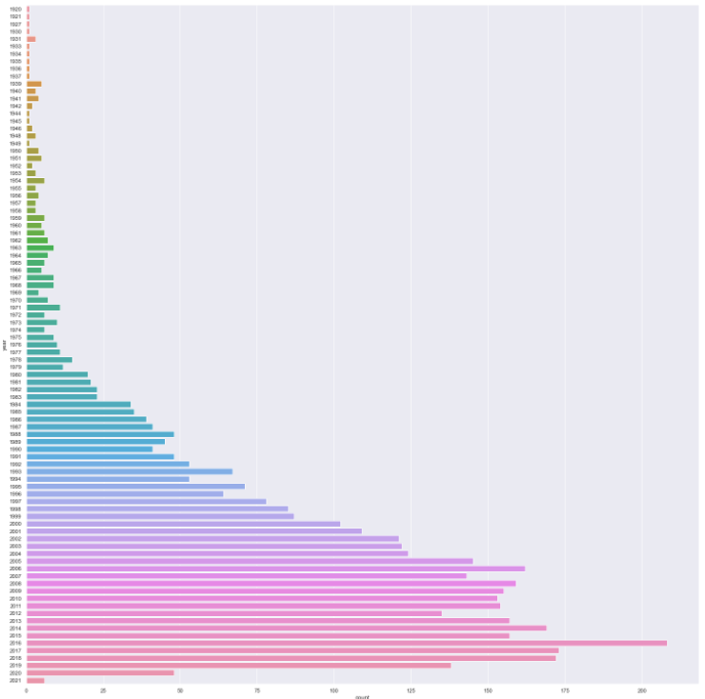
Data Exploration
A catplot of number of movies produced over the years from 1920 to 2021:

Slide 33
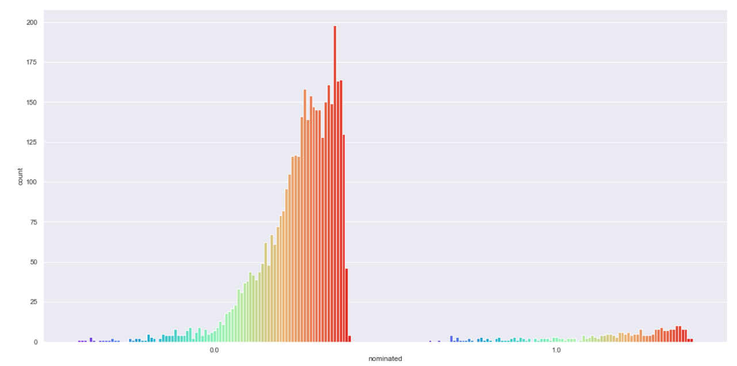
Data Exploration
Count plot of movies released over the years with a differentiator between nominated and not nominated:

Slide 34
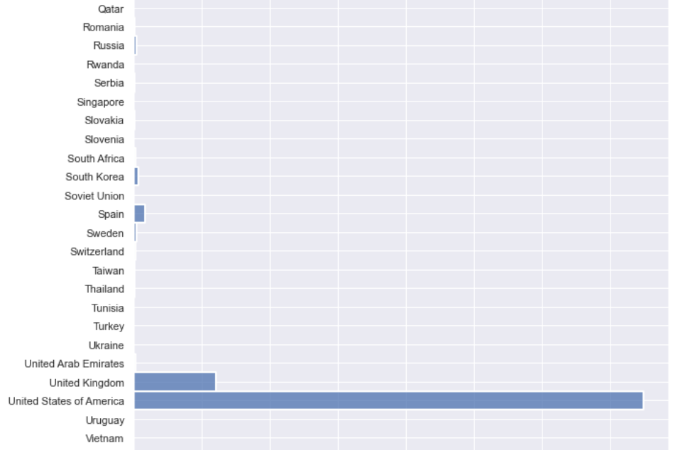
Data Exploration
A histogram of the production countries against the number of movies each country has produced:
A large percentage of movies are produced by the United States of America

Slide 35
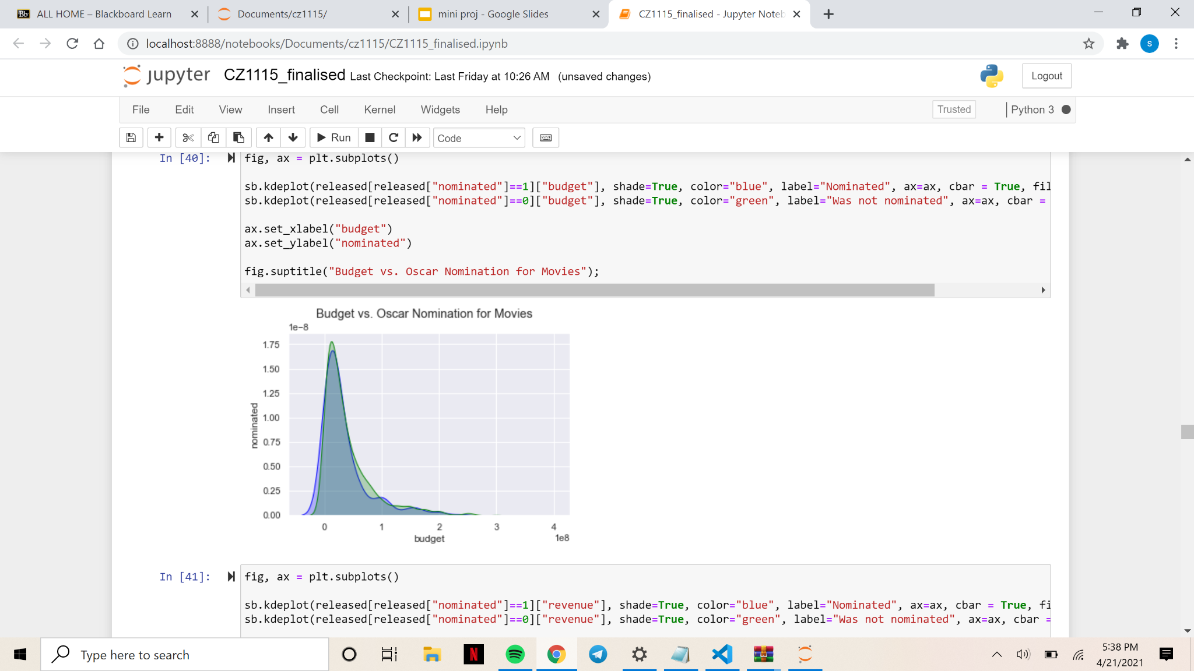
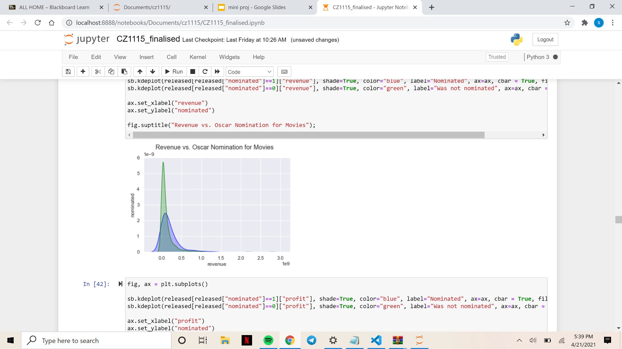
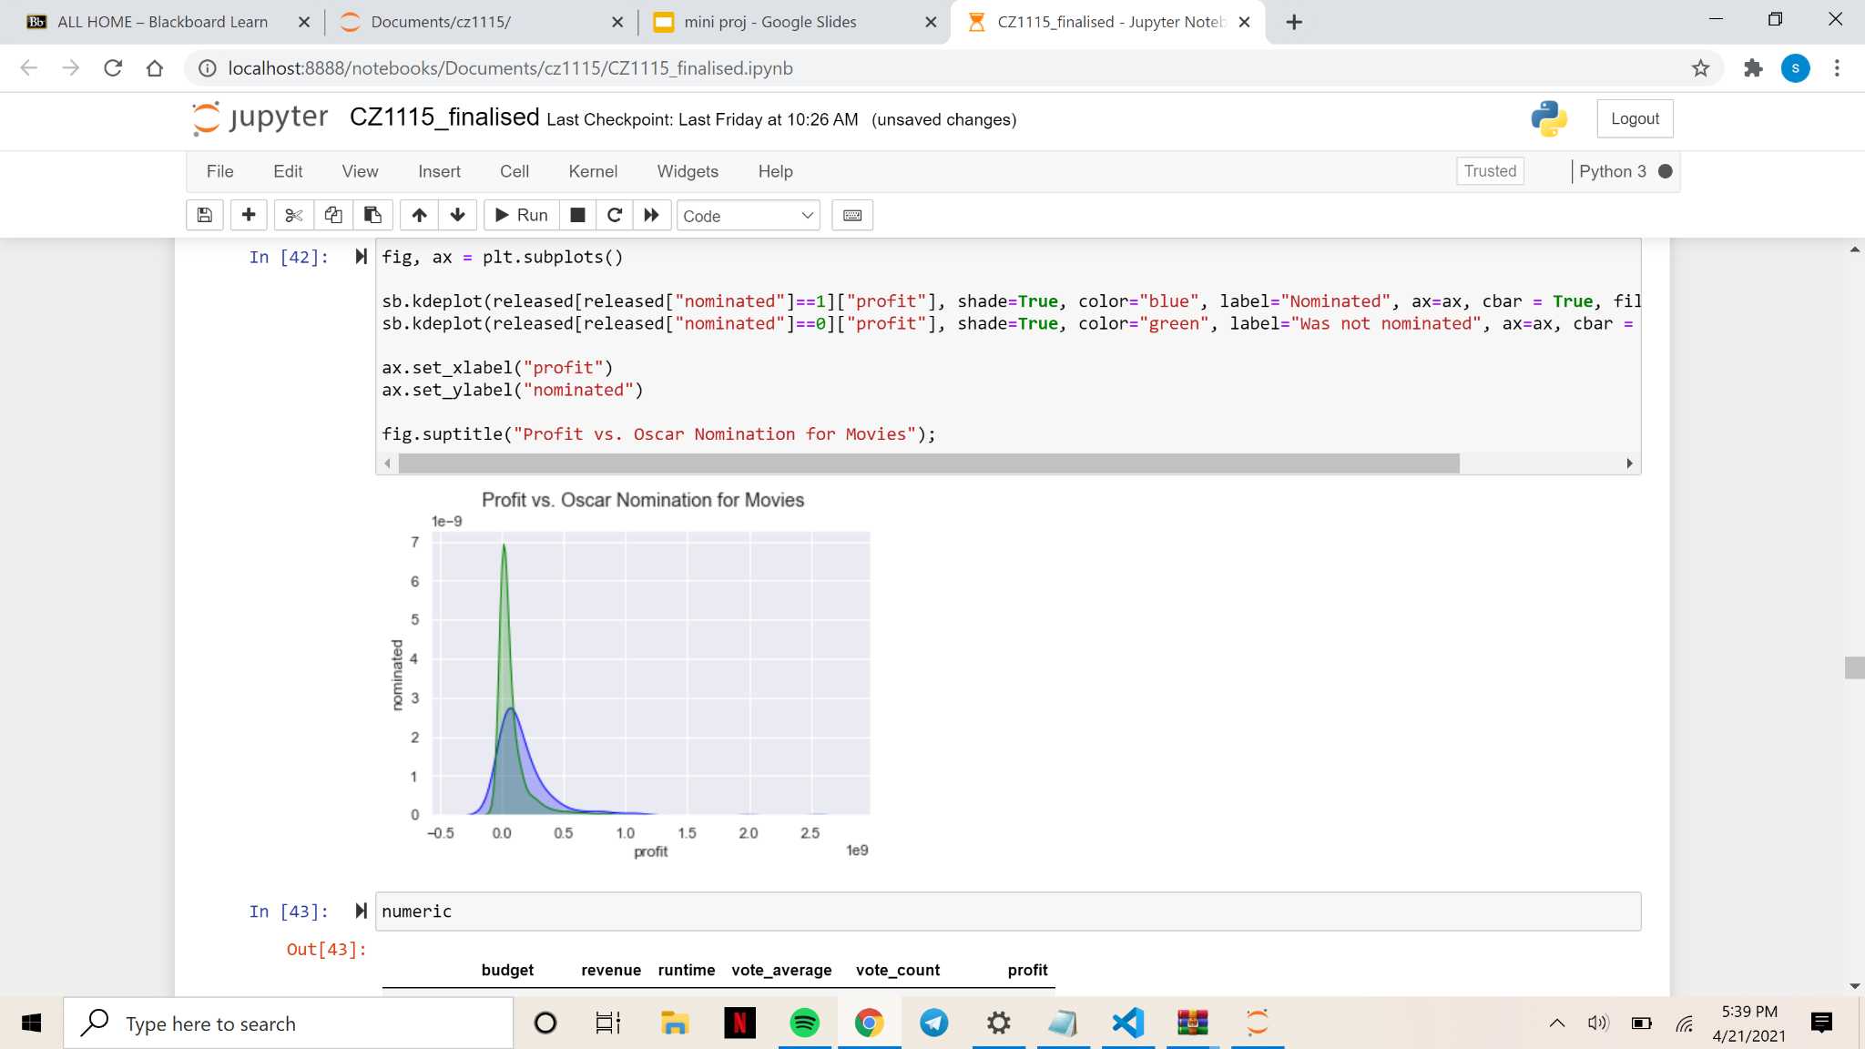
Data Exploration
KDE plots for Oscar nominations against budget, revenue and profit respectively:
Blue: Nominated
Green: Not nominated

Slide 36
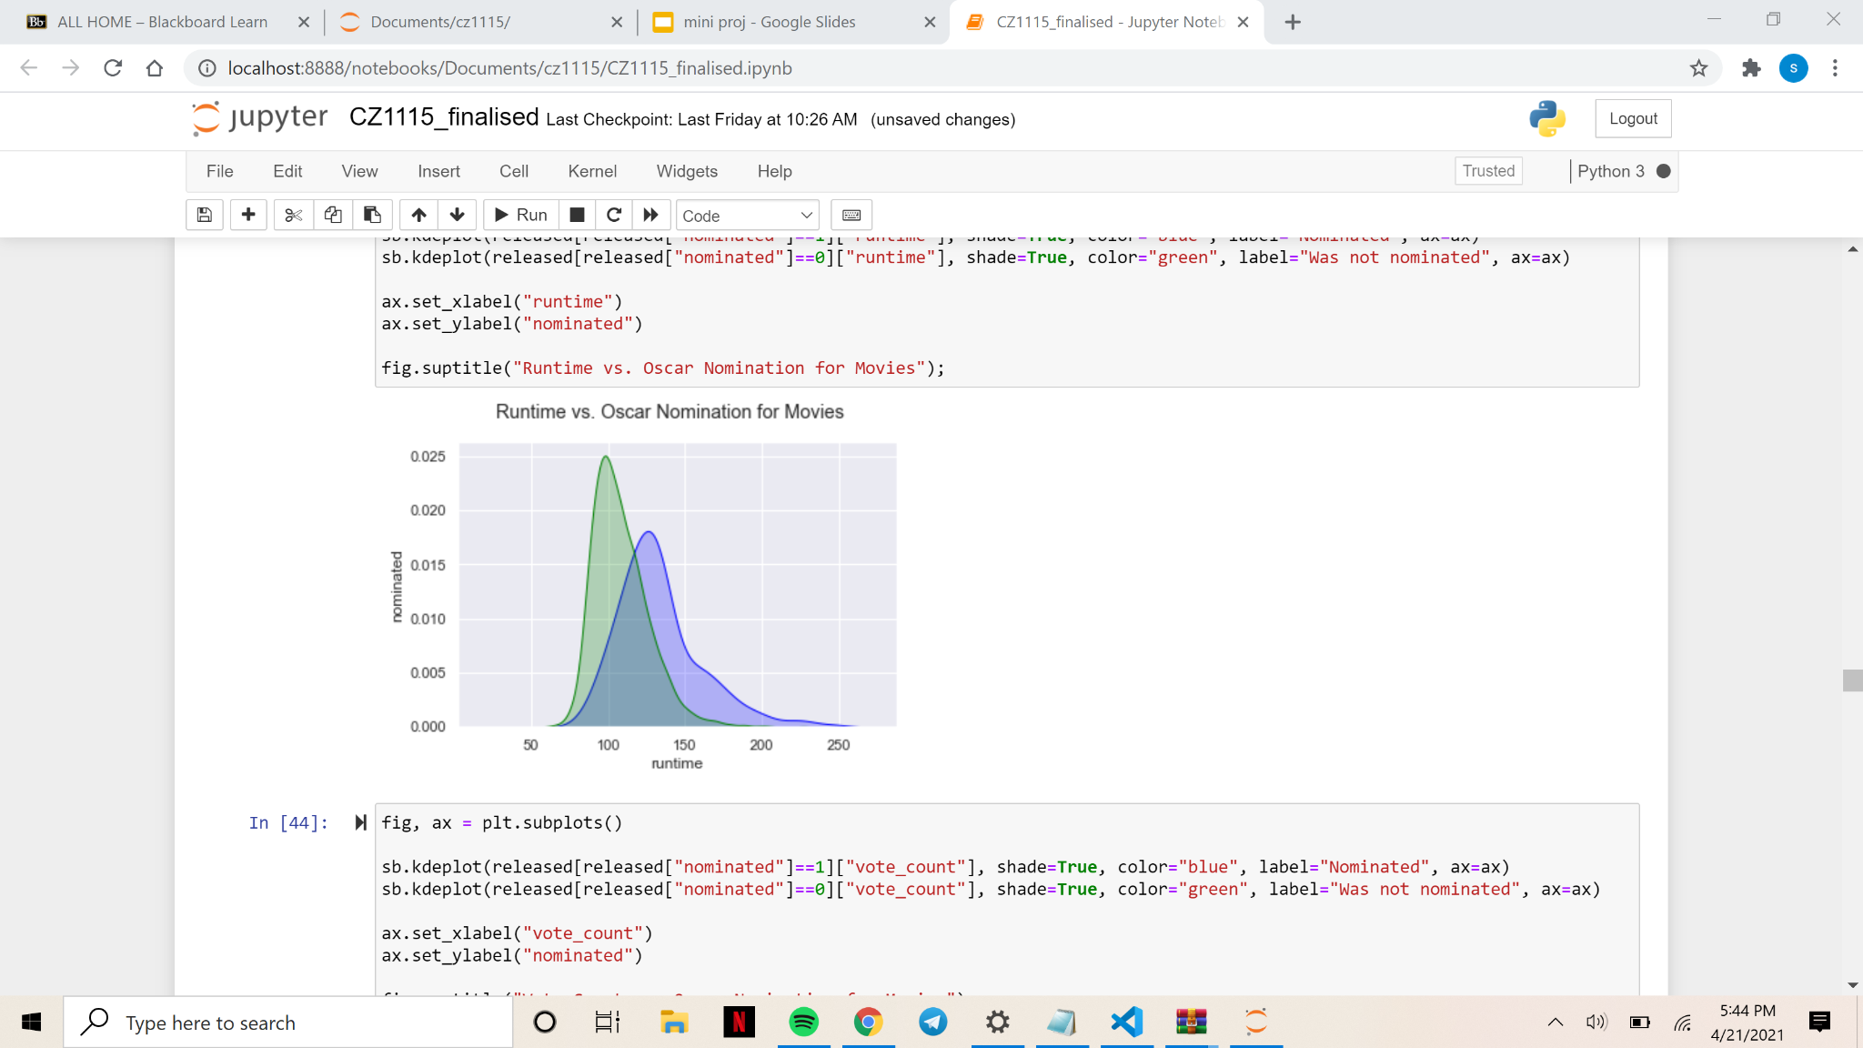
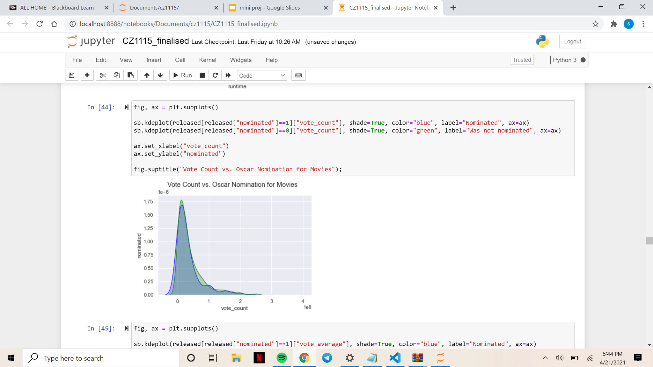
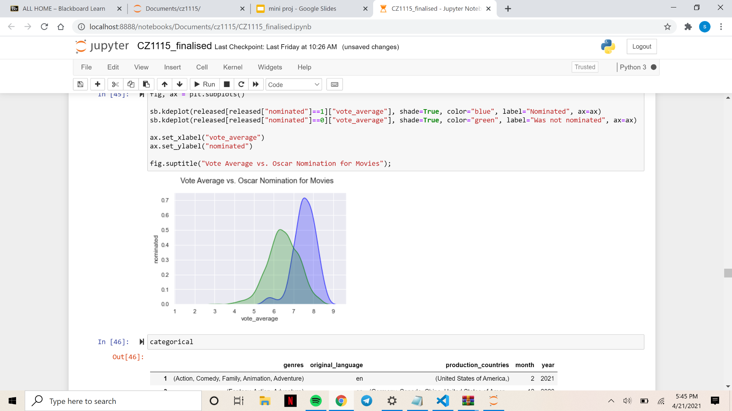
Data Exploration
KDE plots for Oscar nominations against runtime, vote count and vote average respectively:

Slide 37
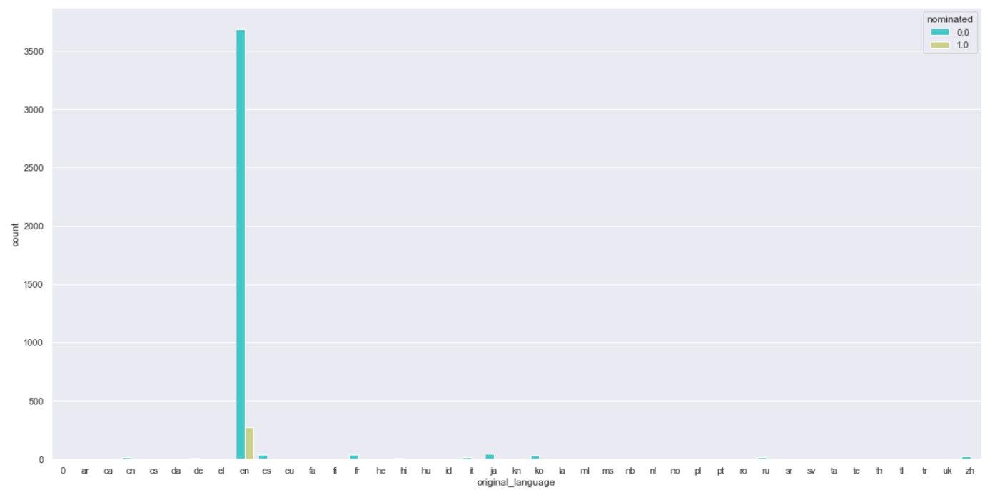
Data Exploration
Count plot of original_language with nominated movies highlighted in green hue:
Most of the nominated movies has English as its original language

Slide 38
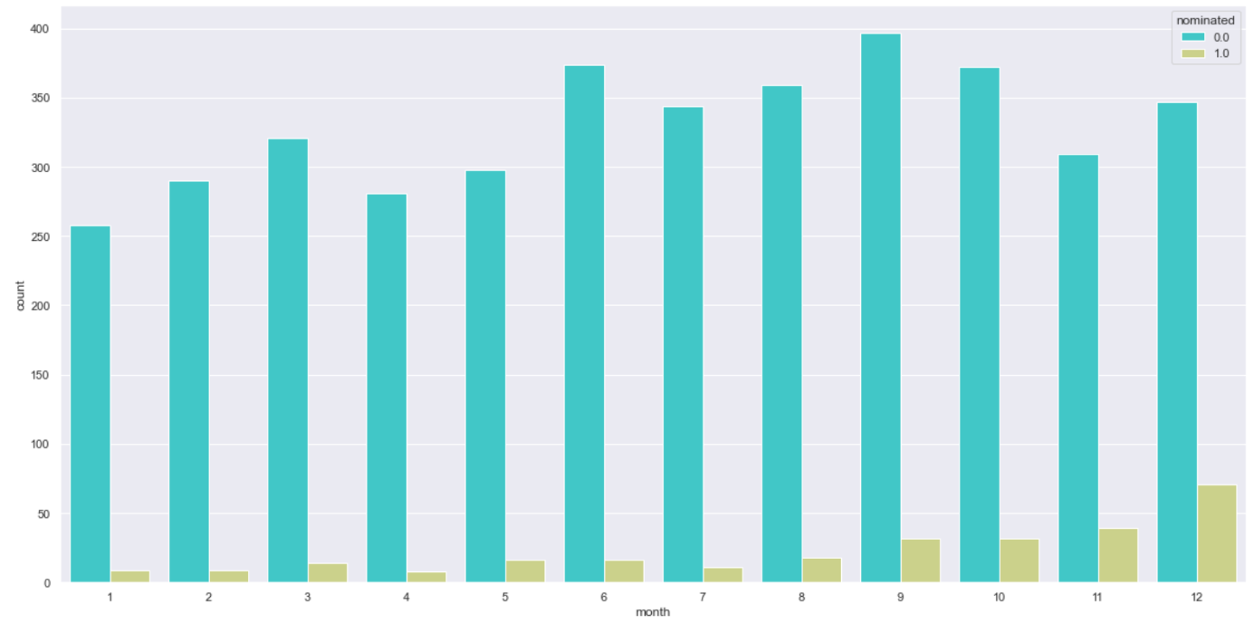
Data Exploration
Count plot of the month the movie was released, with nominated movies highlighted in green hue:
Movies released in December garnered the most nominations

Slide 39
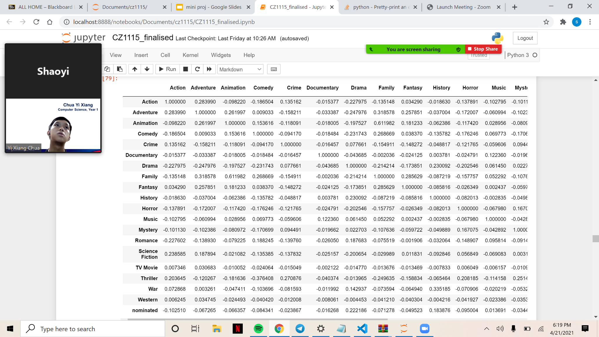
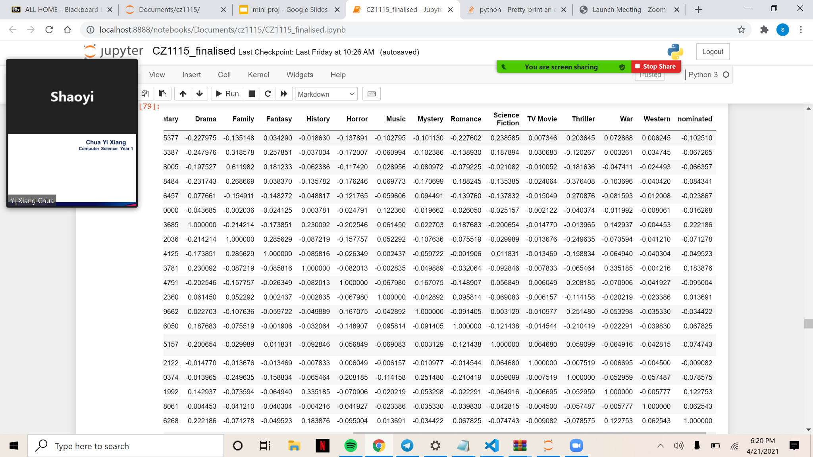
Data Exploration
Correlation between genre and oscar nominations

Slide 40

Classification & Prediction
6.

Slide 41
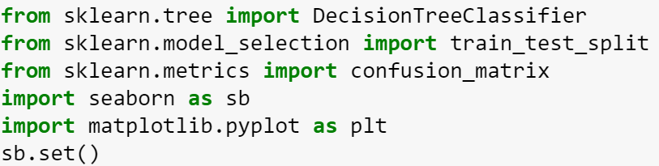
Classifications & Prediction
Import DecisionTreeClassifier, train_test_split selection and confusion_matrix from sklearn

Slide 42
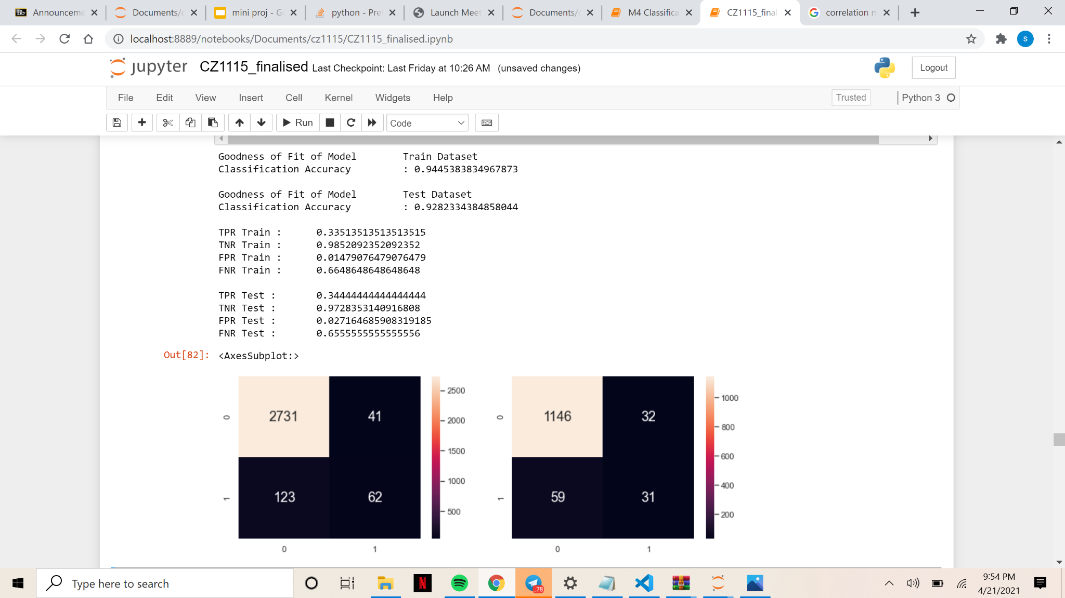
Classifications & Prediction
Check the Goodness of Fit of Model, Classification Accuracy, and the False Positive Rate/ False Negative Rate

Slide 43
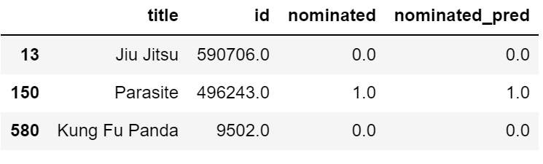
Classifications & Prediction
Individually tested decision tree classifier on three randomly picked samples from the list

Slide 44
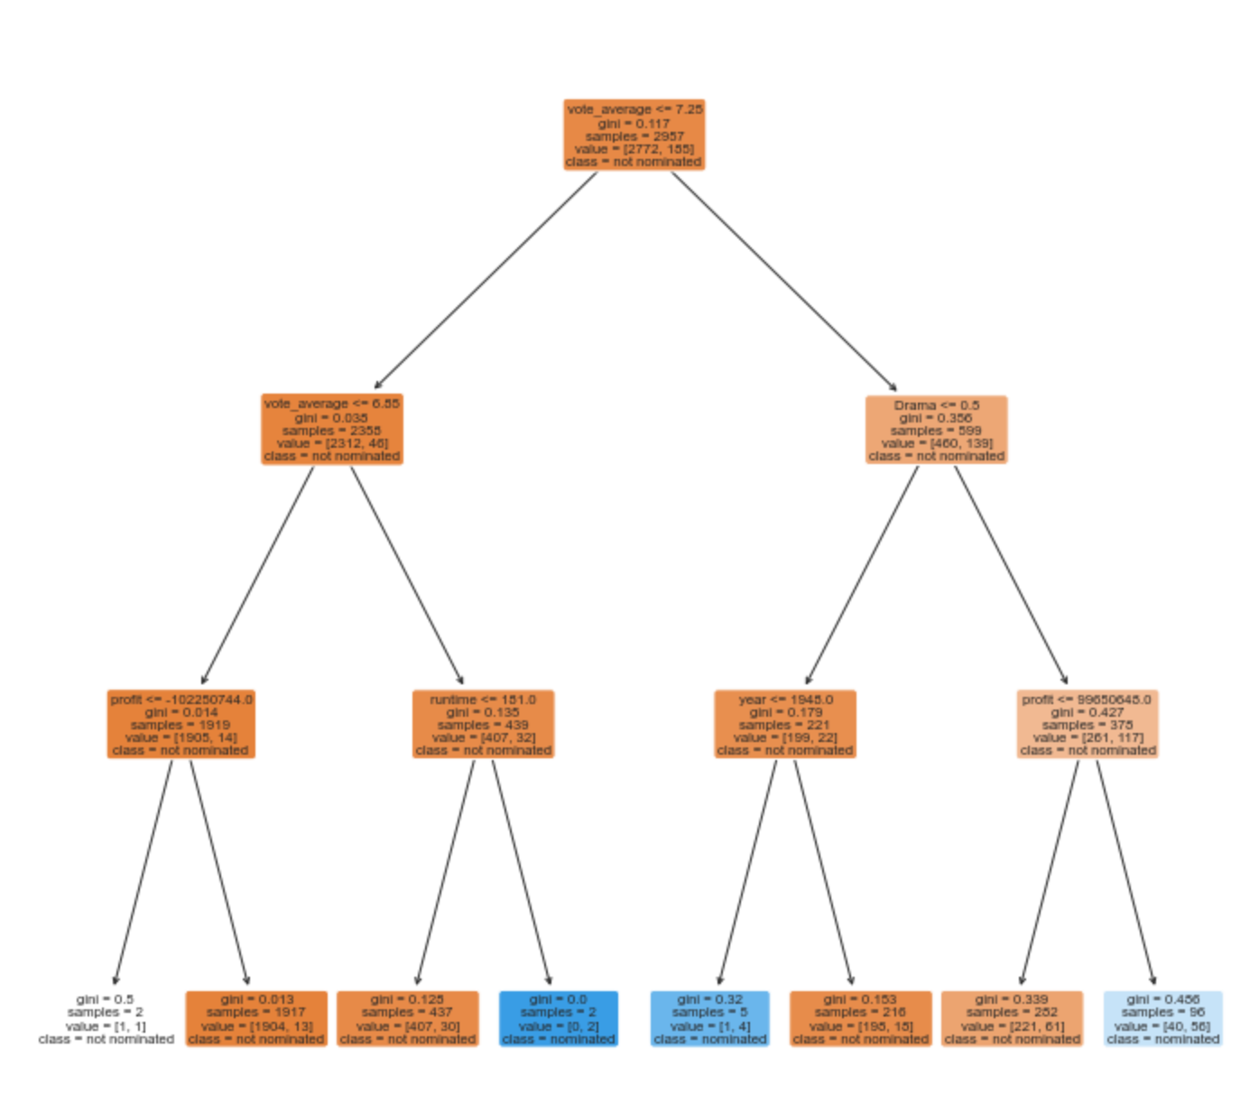
Classifications & Prediction
Predicting the probability that a movie will win an Oscars Awards using a Decision Tree

Slide 45
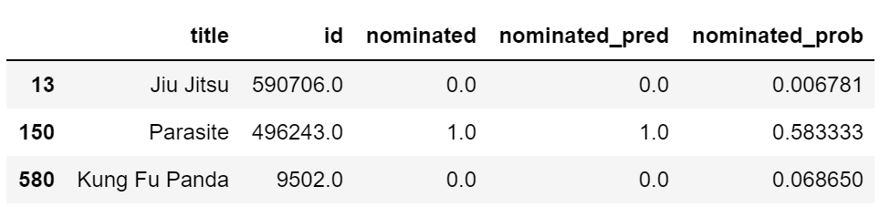
Classifications & Prediction
Predicting the probability that a movie will win an Oscars Awards using a Decision Tree

Slide 46

Random Forest
7.

Slide 47
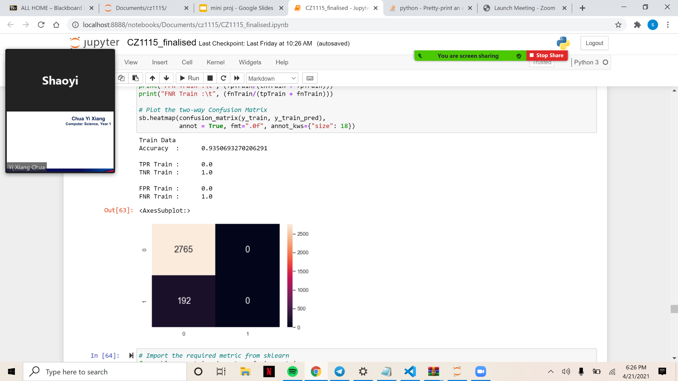
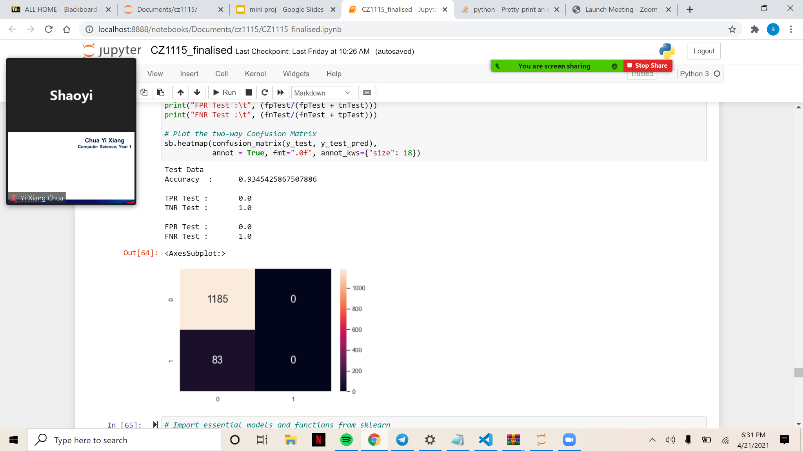
Random Forest
Accuracy and Confusion Matrix for Train and Test Data when number of estimators is 100 and maximum depth is 4:

Slide 48
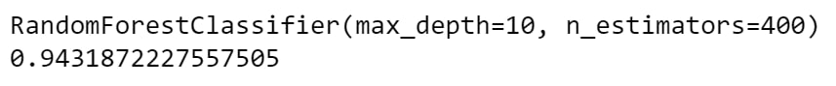
Random Forest
After hyperparameter tuning, the most accurate model has a max depth of 10 and 400 estimators:

Slide 49
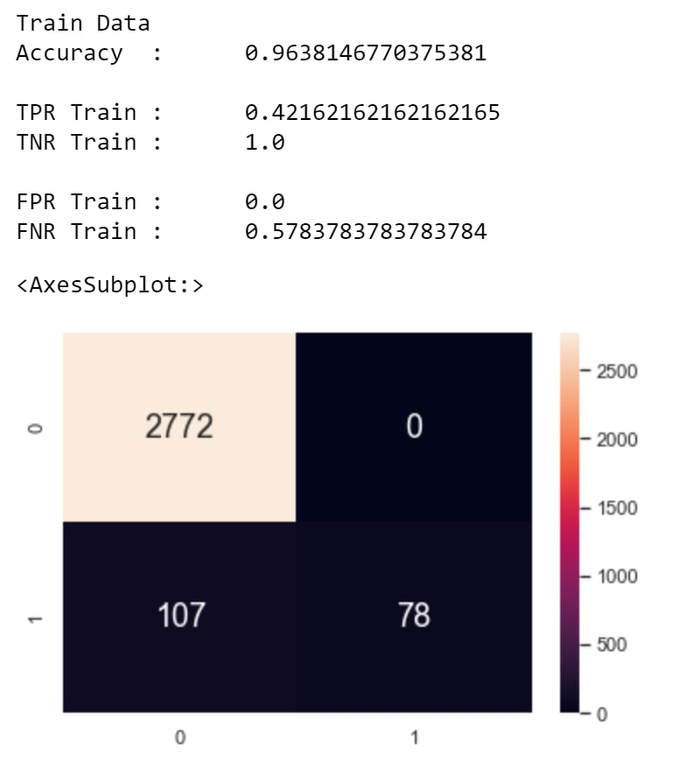
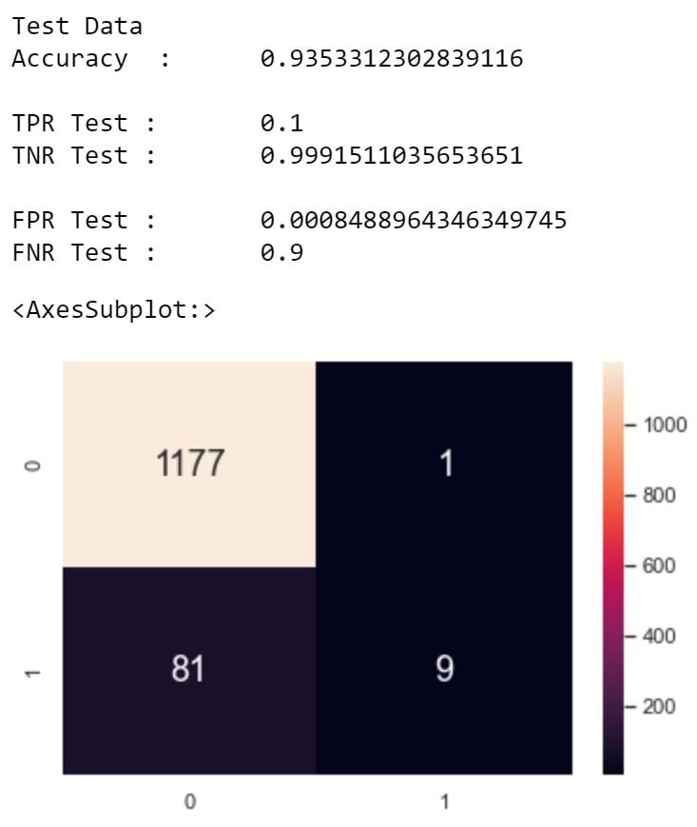
Random Forest
Accuracy and Confusion Matrix for Train and Test Data when number of estimators is 400 and maximum depth is 10:

Slide 50

Results from Classification
Results from Random Forest
No. of estimators: 100
Max depth: 4
No. of estimators: 1000
Max depth: 10
After Hypertuning,
No. of estimators: 400
Max depth: 10

Slide 51

Random Forest
The Random Forest:

Slide 52

Insights & Views
8.

Slide 53
Insights and Views
Based on our Random Forest Tree:
Genre
“Dramas” are most popular
More potential for a better storyline
Production Countries
Most movies in dataset is produced by the US
Vote Average
May not be accurate due to difference in demographics between oscar nominators and TMDB voters
Also depends on the sample size

Slide 54
Insights and Views
Year
A larger percentage of movies are nominated in the past as compared to recent years although there are more movies produced now
Runtime
Affects the amount of content in the movie which affects the overall plot and cohesiveness

Slide 55

Conclusion
9.
Let’s start with the first set of slides

Slide 56
Conclusion
Work allocation:
Lau Xin Wei
Data Extraction
Data Cleaning
Xu Shaoyi
Classification and Prediction
Insights and Views
Chua Yi Xiang
Data Exploration
Random Forest

Slide 57
Reference
TMDB Database https://developers.themoviedb.org/3/getting-started/introduction
Wikipedia Oscars Best Pictures Award https://en.wikipedia.org/wiki/Academy_Award_for_Best_Picture
Took inspiration from lab notebooks

